Slide 1
Signal Representation
Fourier representation
for continuous-time signals
Gen. Fo

Slide 2
Fourier representations
Fourier Series (FS) : for periodic signals
Fourier-Transform (FT) : for nonperiodic signals
Discrete-time Fourier series (DTFS): for discrete-time periodic signals
Discrete-time Fourier transform(DTFT) : for discrete-time nonperiodic signals
Gen. Fo

Slide 3
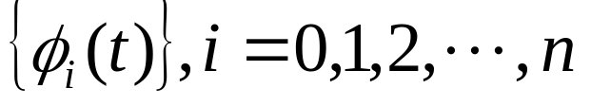
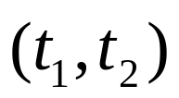
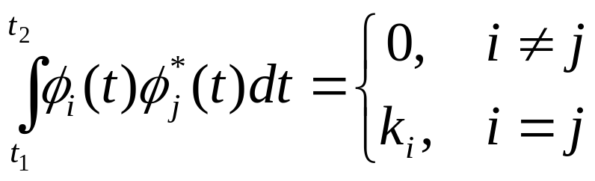
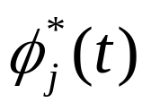
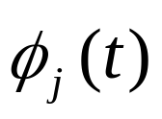
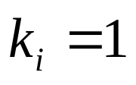
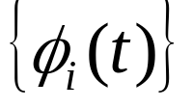
Continuous-time signals
Orthogonal function：
A set of function
Is called orthogonal in the interval
if
where
is the complex conjugate of
if
then
in
is orthonormal
Gen. Fo

Slide 4
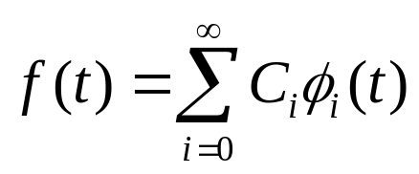
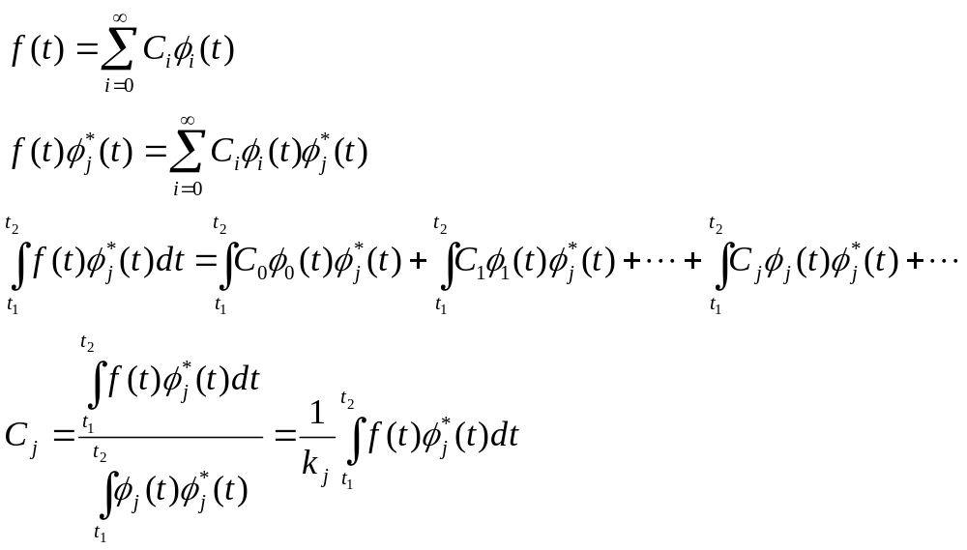
For any function
The question is how to find C_{i}
We choose a orthogonal function set to be the basis
Representation Coefficients (is complex in general)
Euler-Fourier formula
Gen. Fo

Slide 5
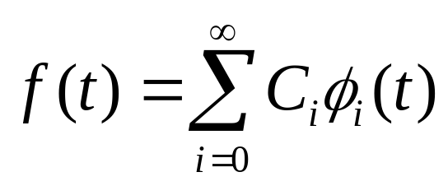
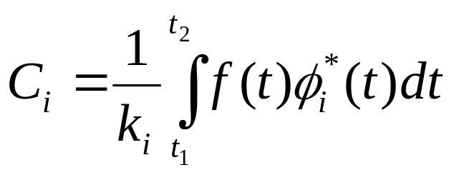
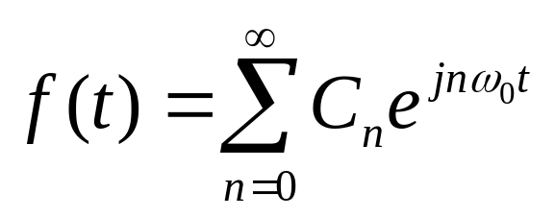
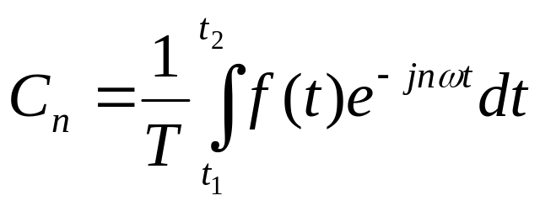
Generalized Fourier series：
Fourier series of function f(t)
Gen. Fo

Slide 6
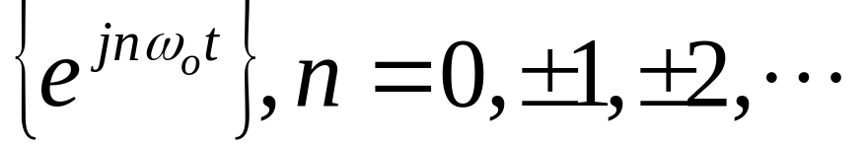
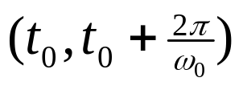
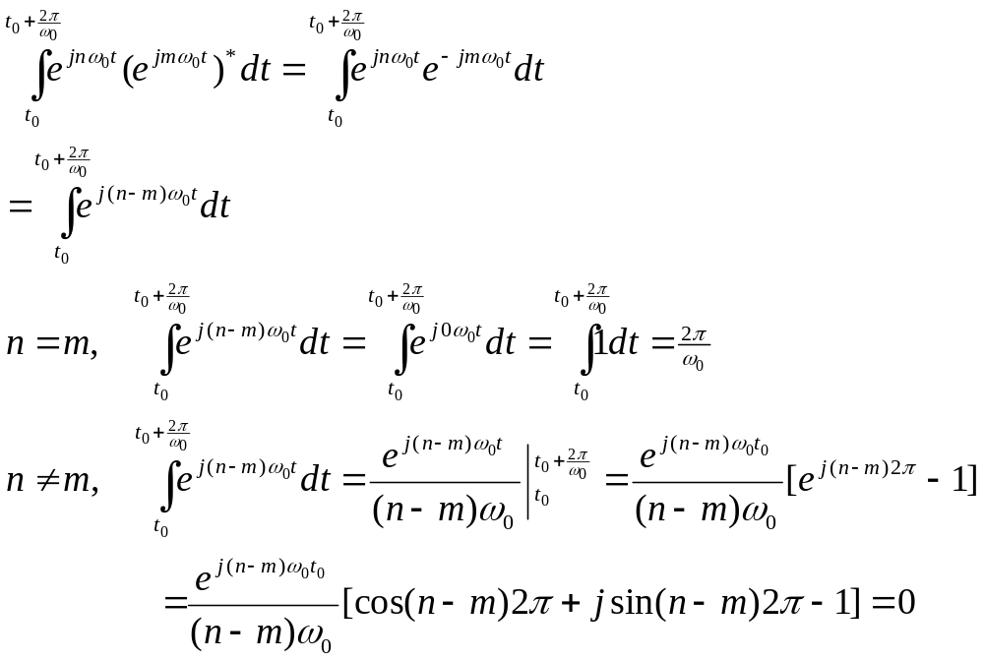
example of orthogonal function :
in the interval
proof
Gen. Fo

Slide 7

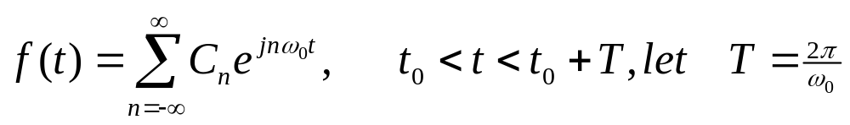
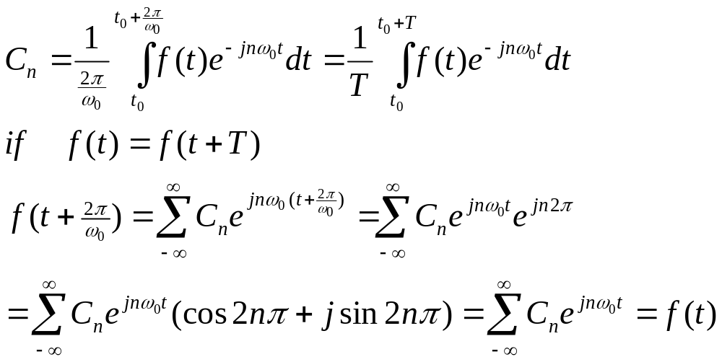
For any function f(t) in the interval
Gen. Fo

Slide 8
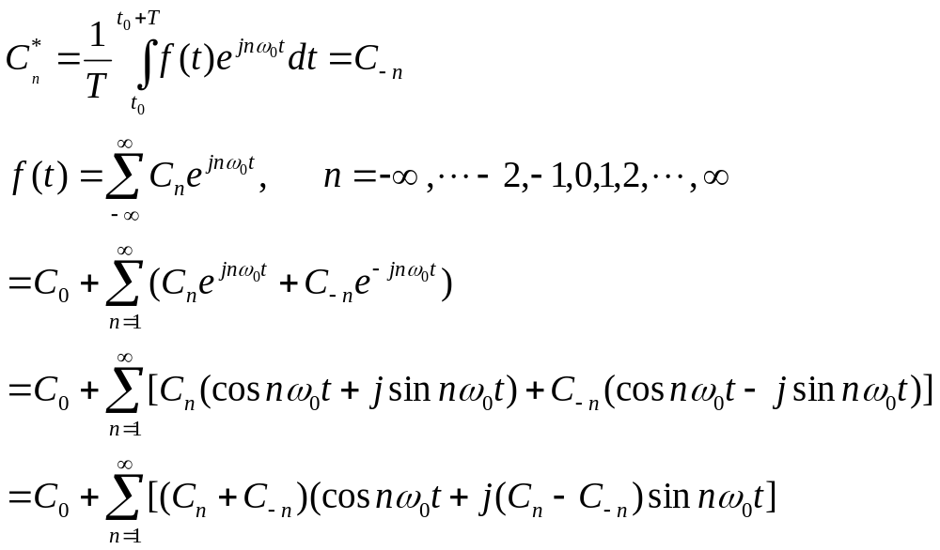
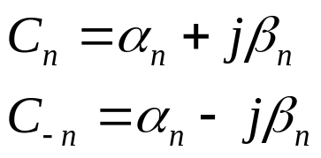
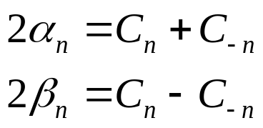
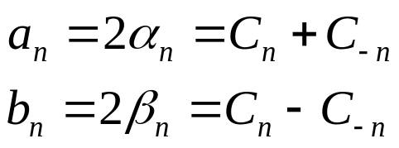
If f(t) is real function
let
let
Gen. Fo

Slide 9
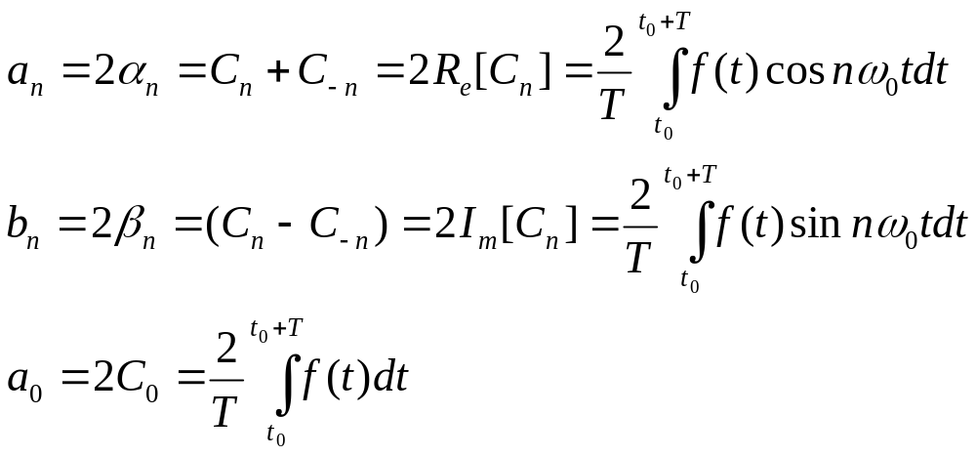
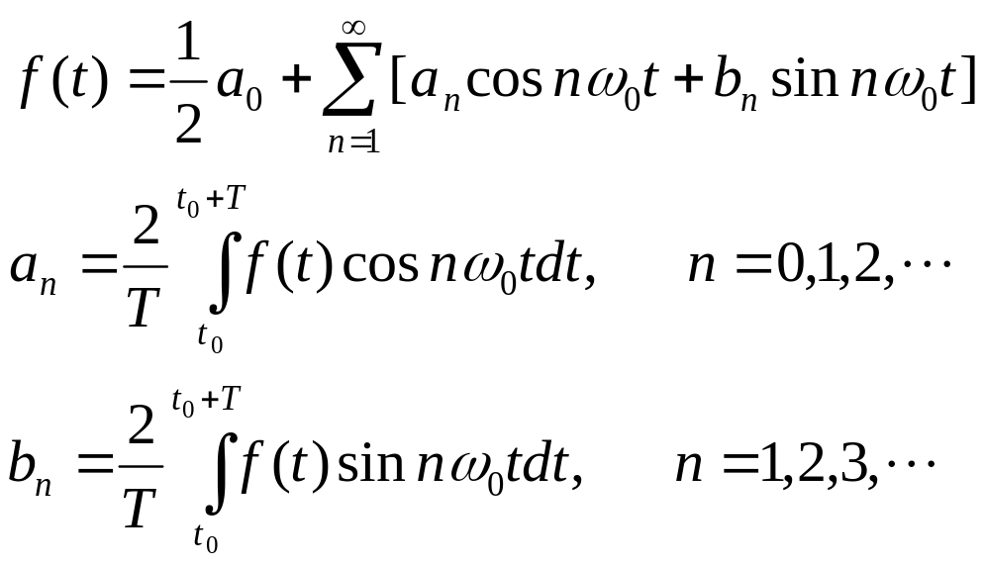
Fourier series：
Gen. Fo

Slide 10
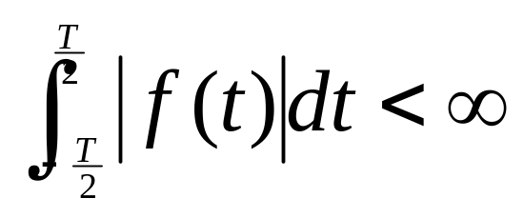
A periodic signal satisfying the following conditions can be extended into an infinite sum of sine and cosine functions.
1.The single-valued function f(t) is bounded, and hence absolutely integrable over the finite period T; that is
2.The function has a finite number of maxima and minima over the period T.
3. The function has a finite number of discountinuity points over the period T.
Gen. Fo

Slide 11
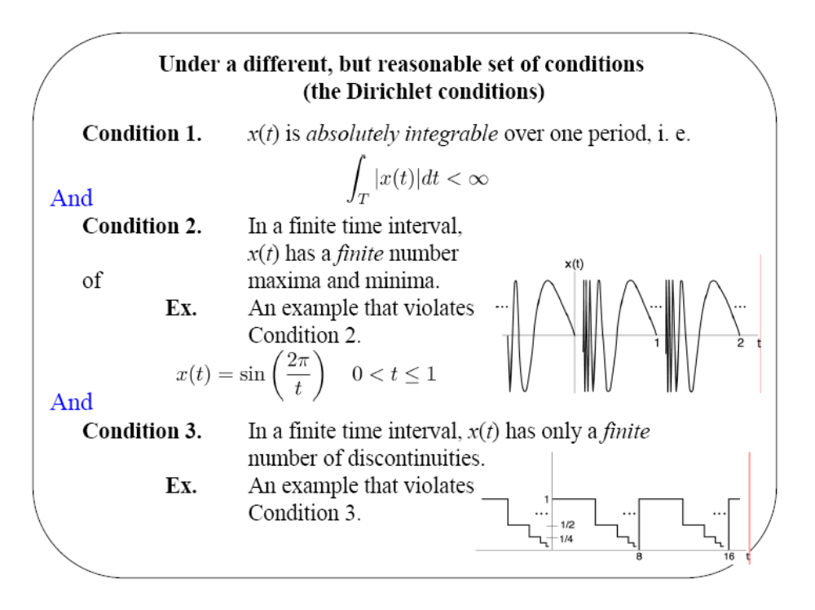
Gen. Fo
MIT signals & systems

Slide 12


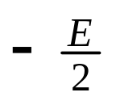

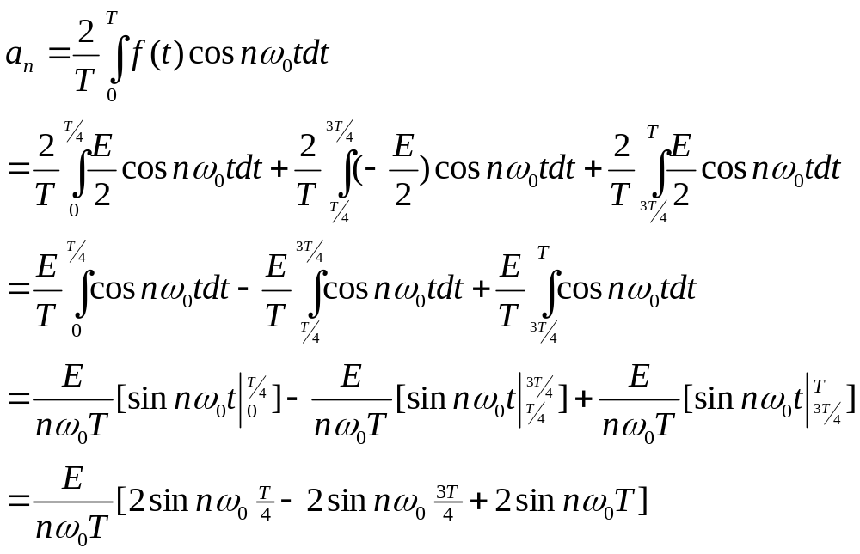
Example:
Gen. Fo

Slide 13


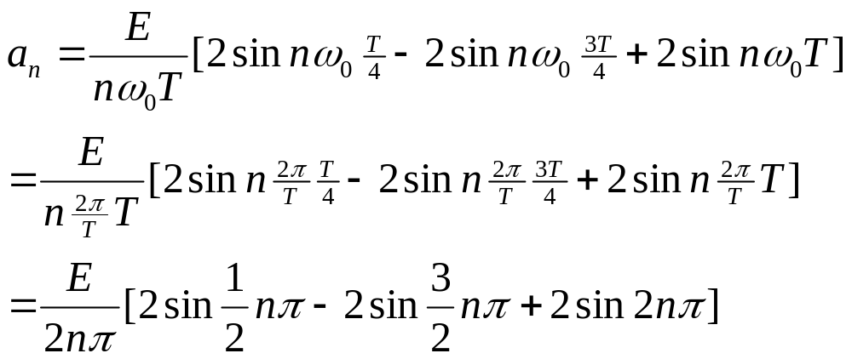
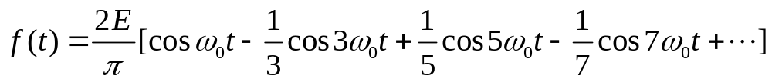

Slide 14







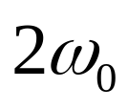
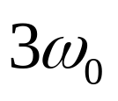
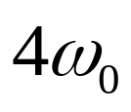
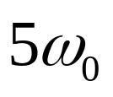


Frequency spectrum
Gen. Fo

Slide 15
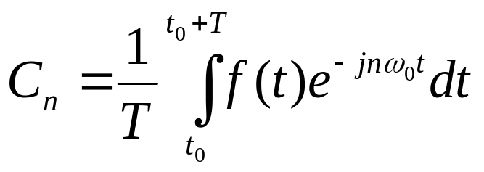
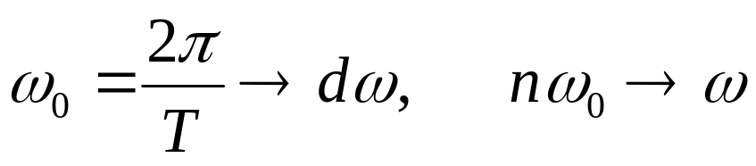
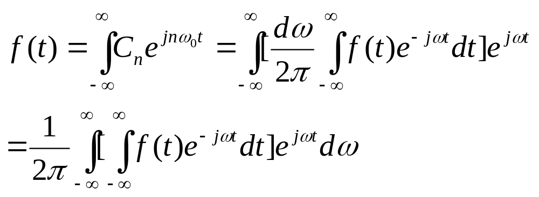

Fourier transform
f(t) is not periodic function if T→∞
Gen. Fo

Slide 16
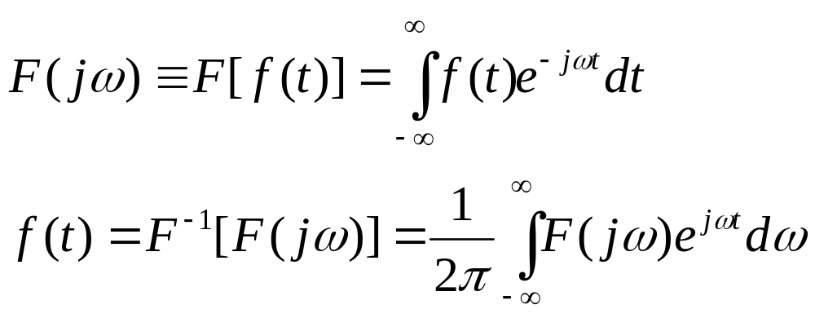
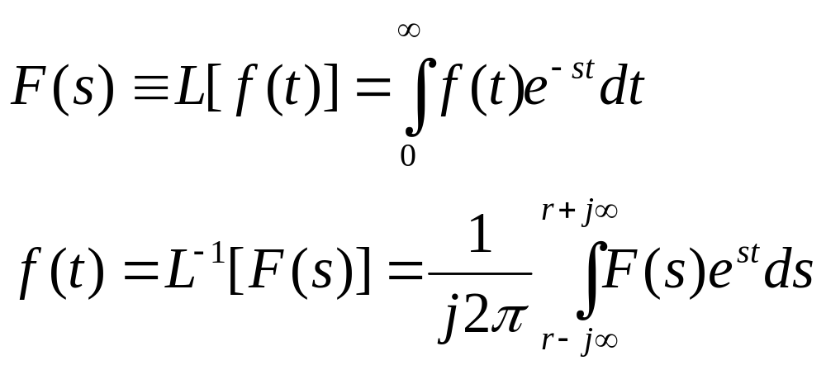
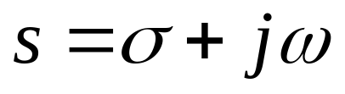
Fourier transform of f(t)
Inverse Fourier transform
Comparing with Laplace transform
Gen. Fo

Slide 17
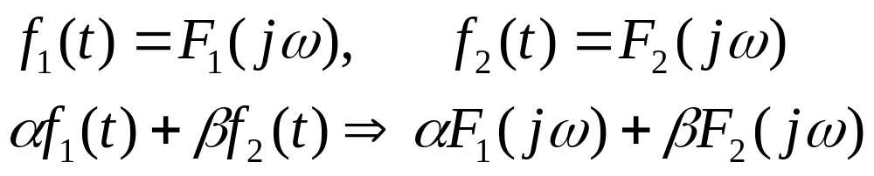
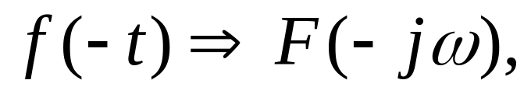
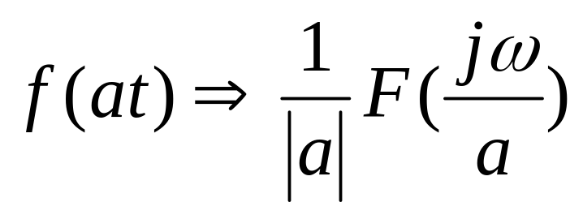
The properties of Fourier transform
(i) Linearity
(ii) Reversal
(iii) Scaling in time
Gen. Fo

Slide 18
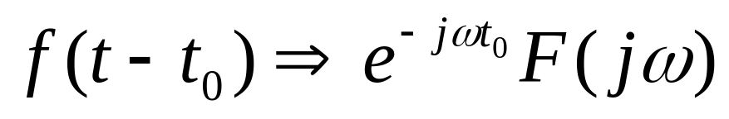
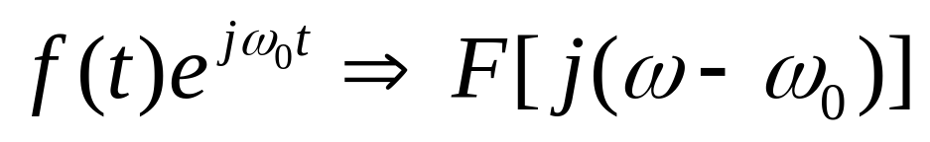
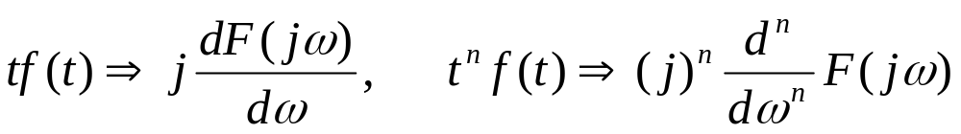
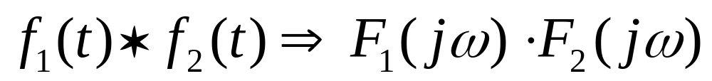
(iv) Delay
(v) Frequency shifting modulation
(vi) Frequency differentiation
(vii) Convolution
Gen. Fo

Slide 19
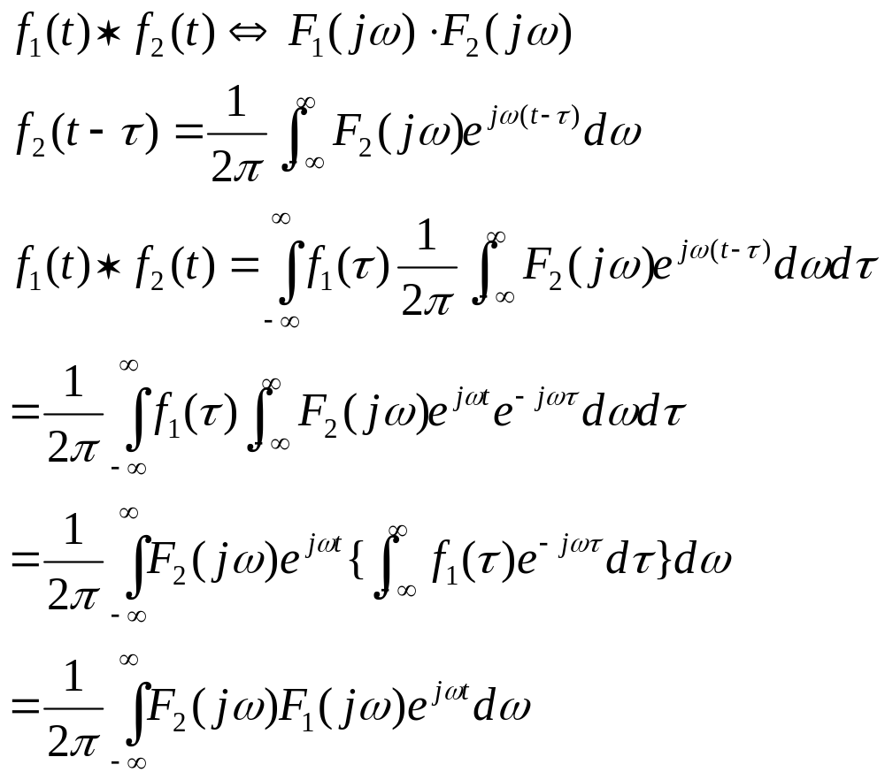
Gen. Fo

Slide 20
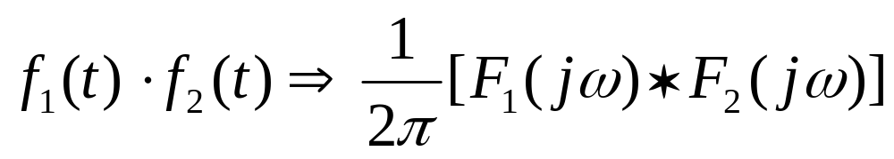
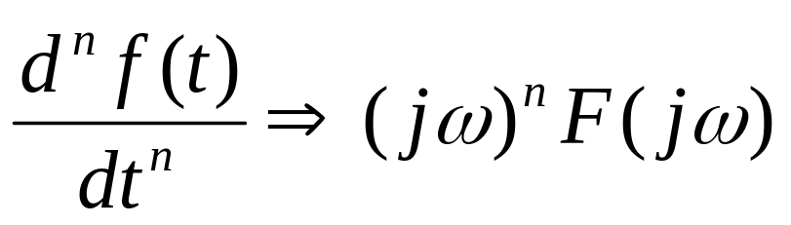


(viii) multiplication
(ix) Derivative
(x) Integration
Gen. Fo

Slide 21





example
Gen. Fo

Slide 22






Gen. Fo

Slide 23

example
Gen. Fo

Slide 24


example
Gen. Fo

Slide 25



Cardinal sine function
Gen. Fo

Slide 26




Parseval’s theorem (時域頻域能量守恒)
If f(t) is real function
Gen. Fo

Slide 27

Example
Gen. Fo

Slide 28


Gen. Fo

Slide 29












Example: Fourier series
Gen. Fo

Slide 30


Gen. Fo

Slide 31




Example : Fourier transform
Gen. Fo

Slide 32

Gen. Fo

